Slide 1

NCL Cyber Exercise Resource Monitor System
Program Design Purpose
We want to create a monitor and observing tool-set which can visualize and evaluate the availability of the resource ( hardware, vms, container, program or service) being used in an on-going cyber exercise or a cyber drill event to help the event organizers and participants to get better sense about the event real time progress. It also provide serval function to full filled the requirement of other teams in the cyber exercise. The main functions provide by the cyber exercise resource monitor which can be used by different teams:
Used by the Black/Judgment-Team to monitor the whole exercise progress, each teams’ state/score, the availability of the resource and the defense progress.
Used by the Green-Team to prepare, test and do debug work for building and supporting the exercise environment.
Used by the Blue-Team to check and monitor the real time state of the exercise environment they are working on.
Used by the Red-Team to report the attack state to judgement team and check the attack influence.
Used by the Yellow-Team to simulate the behavior of normal users.
Used by the Purple-Team to record the cyber exercise event timeline and archive the event logs.
Auto detect and record the red team attack and defense action.
The Cyber Exercise Resource Monitor System is built based on two exist products: Cluster User Emulator and Cluster Service Health Monitor.

Slide 2
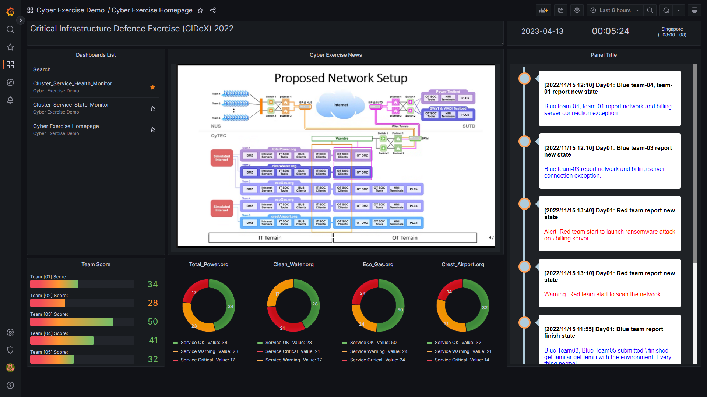
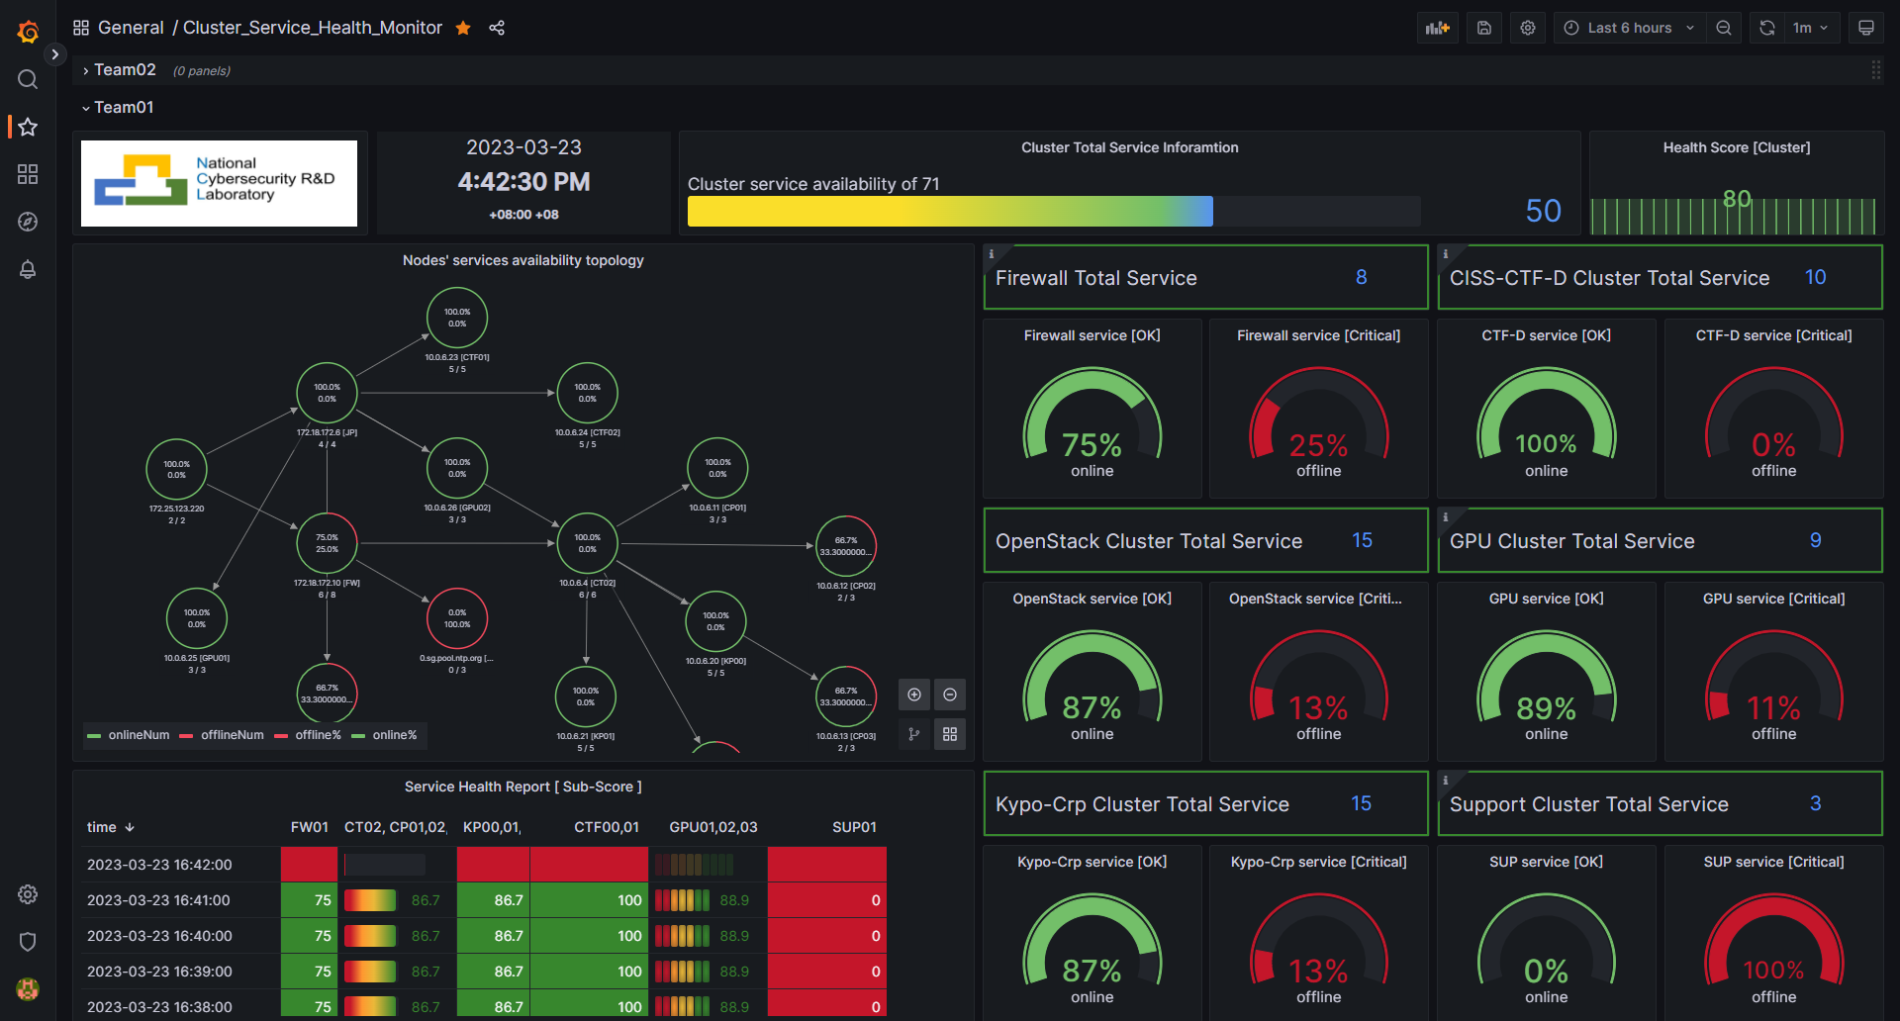
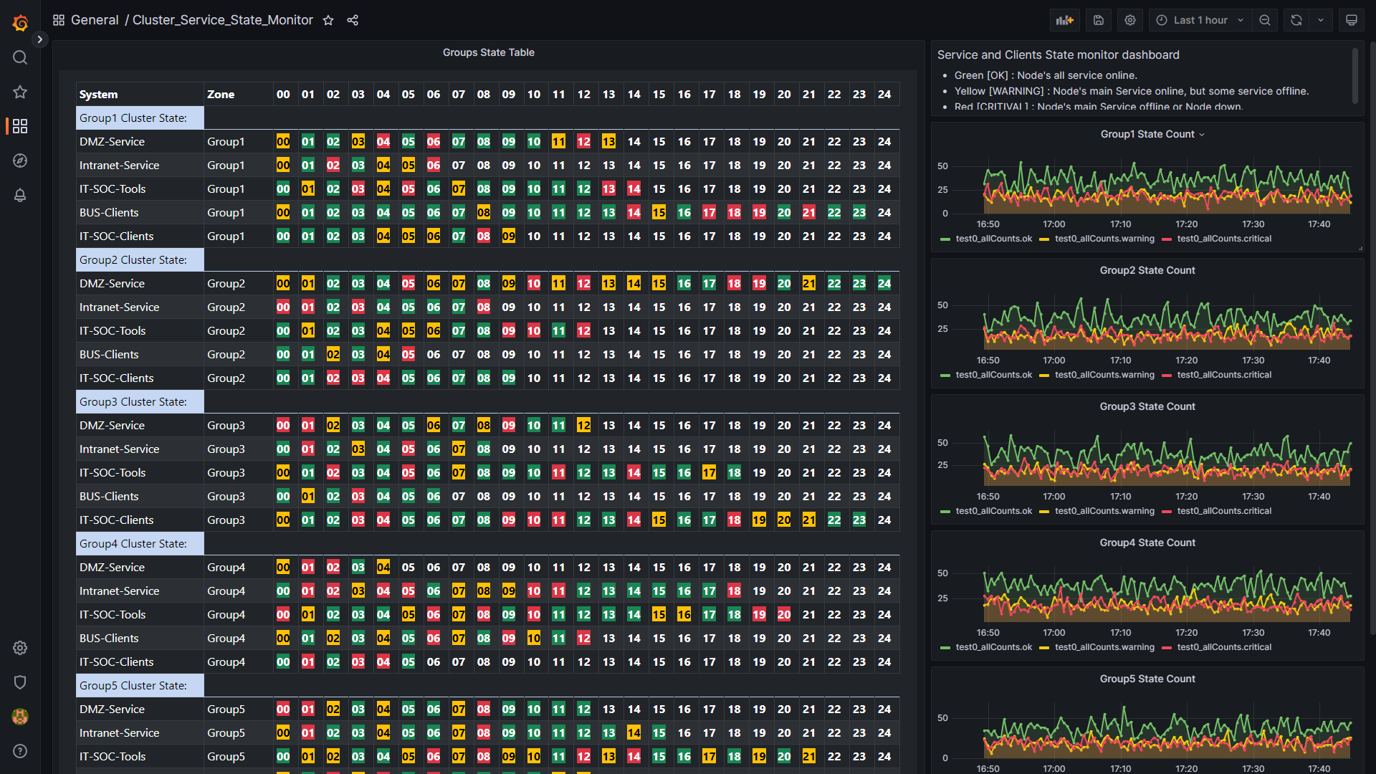
NCL Cyber Exercise Resource Monitor System
Monitor Web Portal (Dashboards)
The Cyber Exercise Resource Monitor System will provide several different web dashboards to visualize the exercise information for different teams’ requirement, currently four main kinds of dashboards are provided:
Exercise Overview Dashboard: Used by the Black/Judgement-Team to monitor and control the whole exercise progress.
Service Health Dashboard: Used by the Blue-Team to monitor health and availability of their team’s exercise-cluster.
Resource Availability Dashboard: Used by the Black/Judgement-Team, Red-Team, Blue-Team and Purple-Team to monitor the detailed real time availability state of the resource.
Information Dashboard: purple-team to post the announcement to blue team, archiving the exercise document, post information to public
Assistance function Dashboards: Used for full fill special monitor requirement of Yellow-Team and Green-Team.
Dashboard Screen Shot:

Slide 3
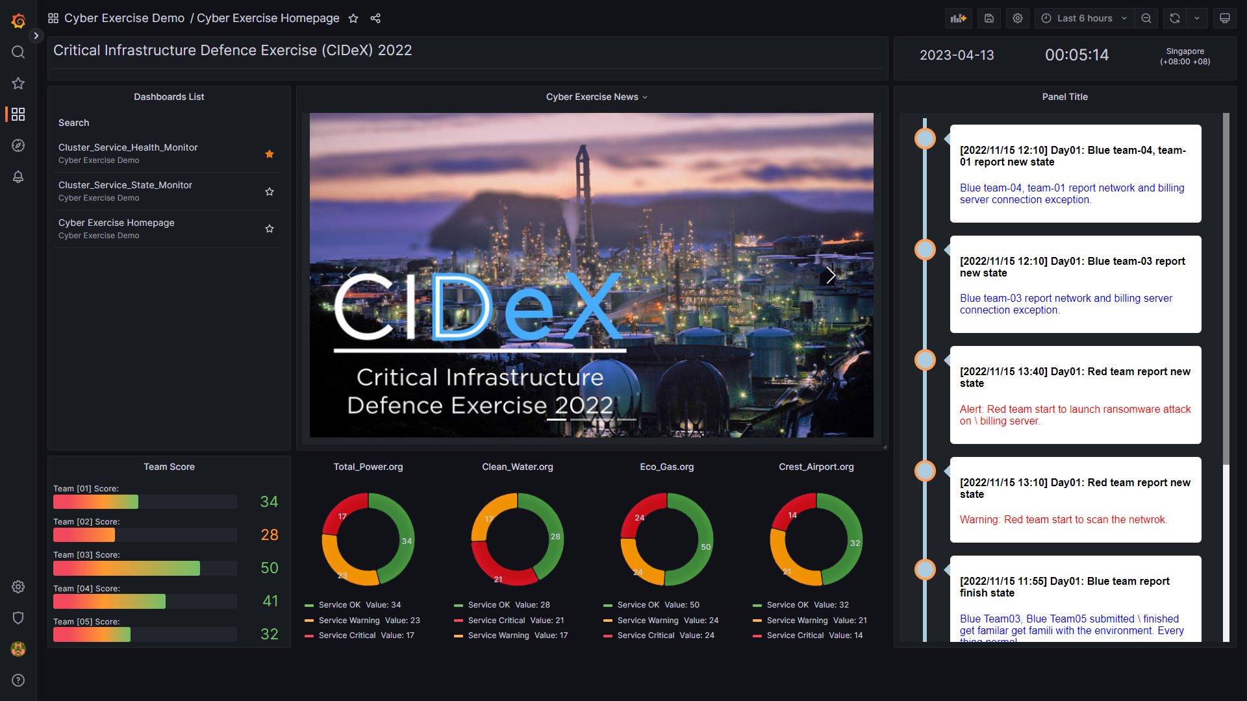
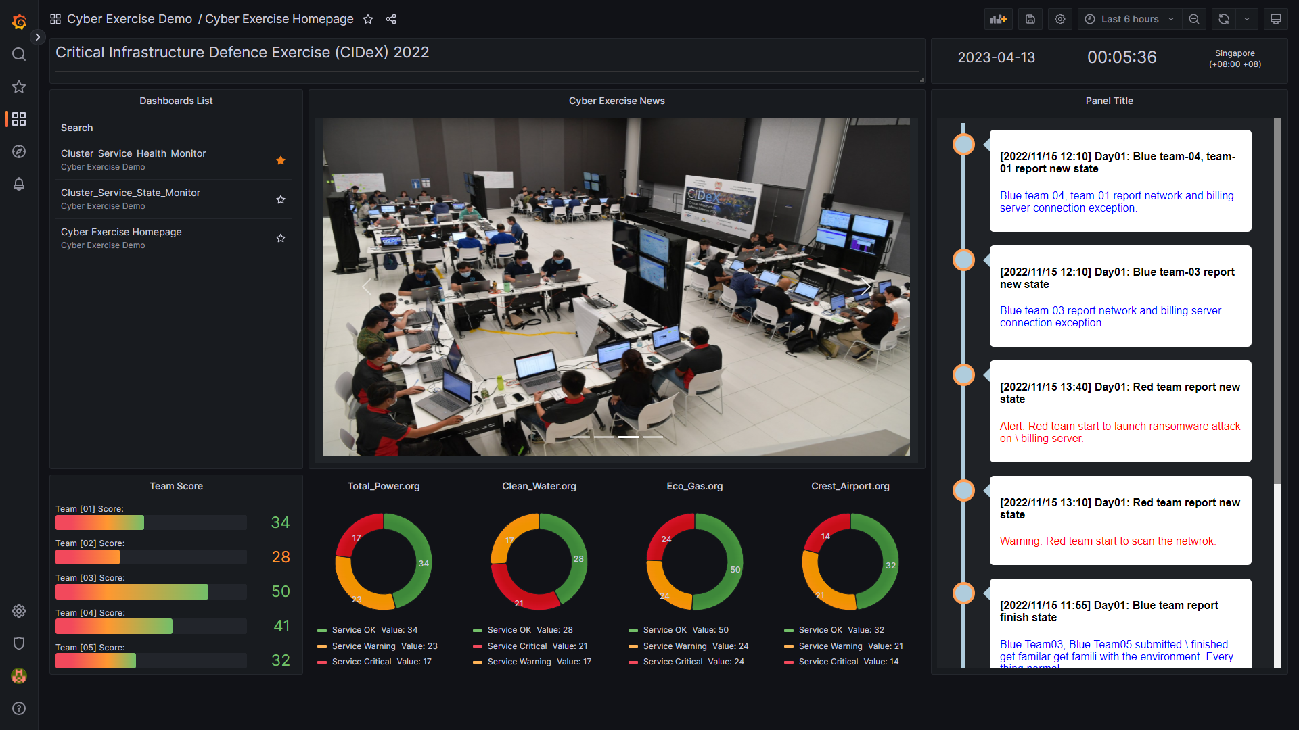
NCL Cyber Exercise Resource Monitor System
1. Exercise Overview Dashboard
The Cyber Exercise Overview Dashboard is used by Black/Judgement-Team to monitor and control the whole exercise progress. The information it will provide:
Latest news of the cyber exercise and the event host venue live video.
Exercise attack and defence state .
The score of all blue teams, summary of tickets raised and resolved.
The availability of all teams’ resources.
Real time exercise events timeline.
Overview dashboard example:

Slide 4
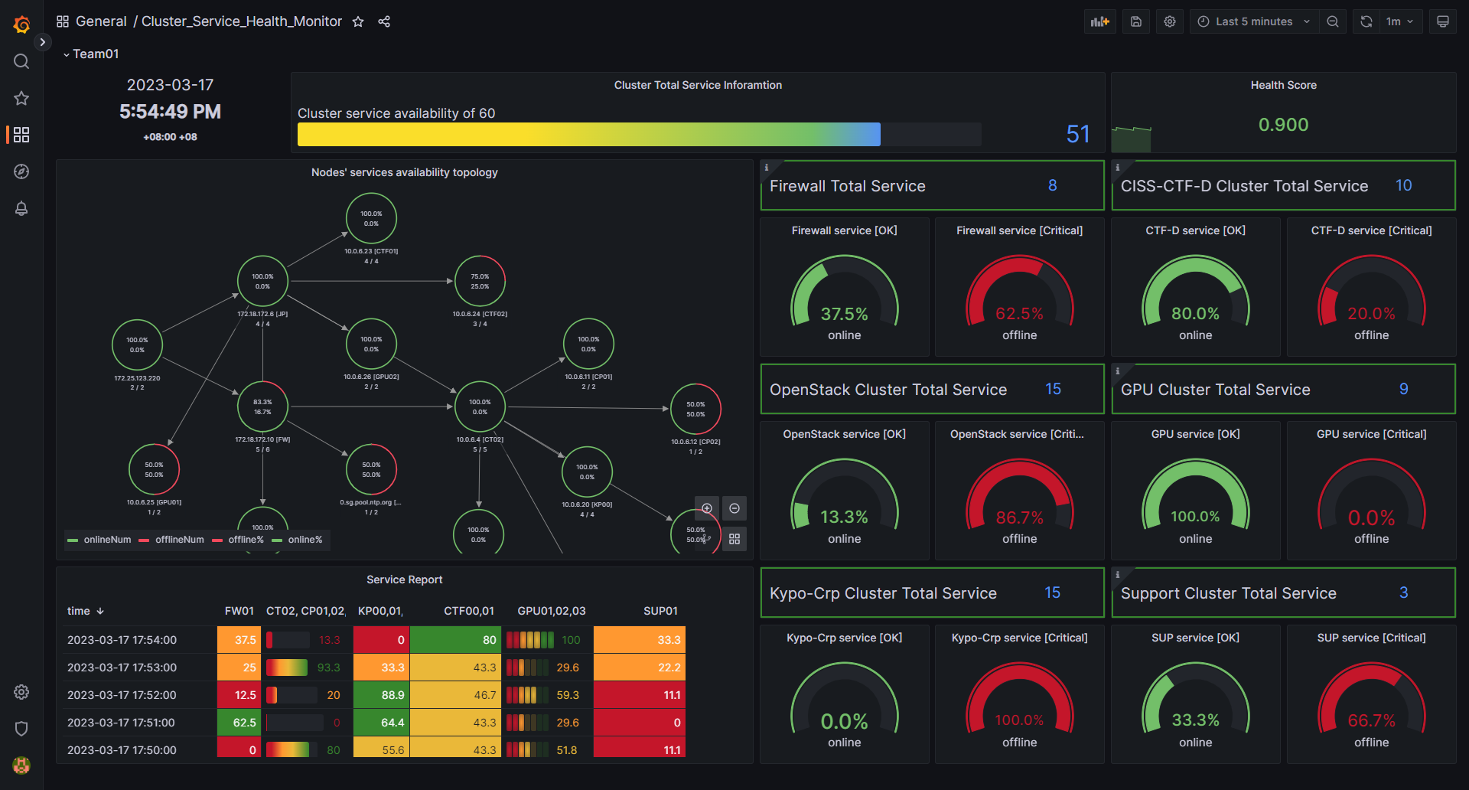
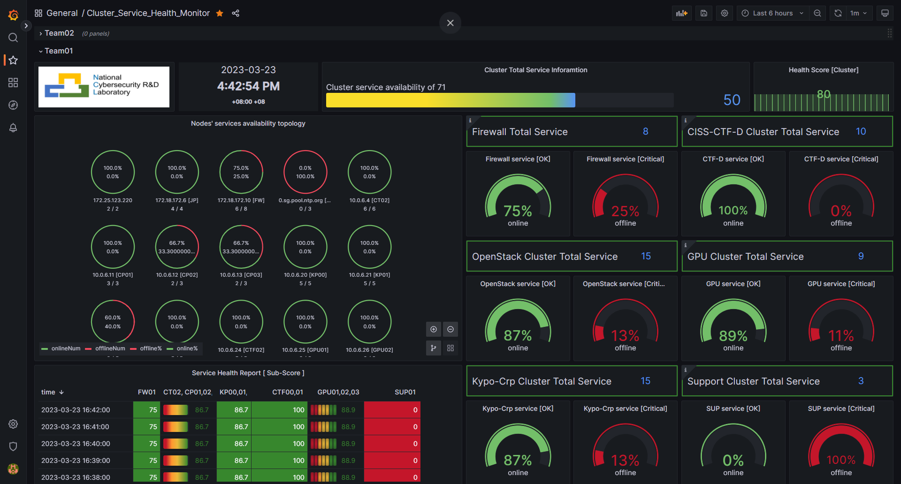
NCL Cyber Exercise Resource Monitor System
2. Service Health Dashboard
The Cyber Exercise Service Health dashboard is used by the Blue-Team to monitor the health and availability of the sub exercise environment/cluster which they are working on. So they can analyse the cluster state, raise tickets and plan the defense action. The information it can provide (Each team will have their own dashboard) :
Nodes health/availability state of the sub exercise environment/cluster.
Environment network topology and traffic state.
Service health/availability and program execution state in the team’s cluster.
The critical host/node login and commands execution state.
Cluster system logs and current team’s defense score.
Service health dashboard example:

Slide 5
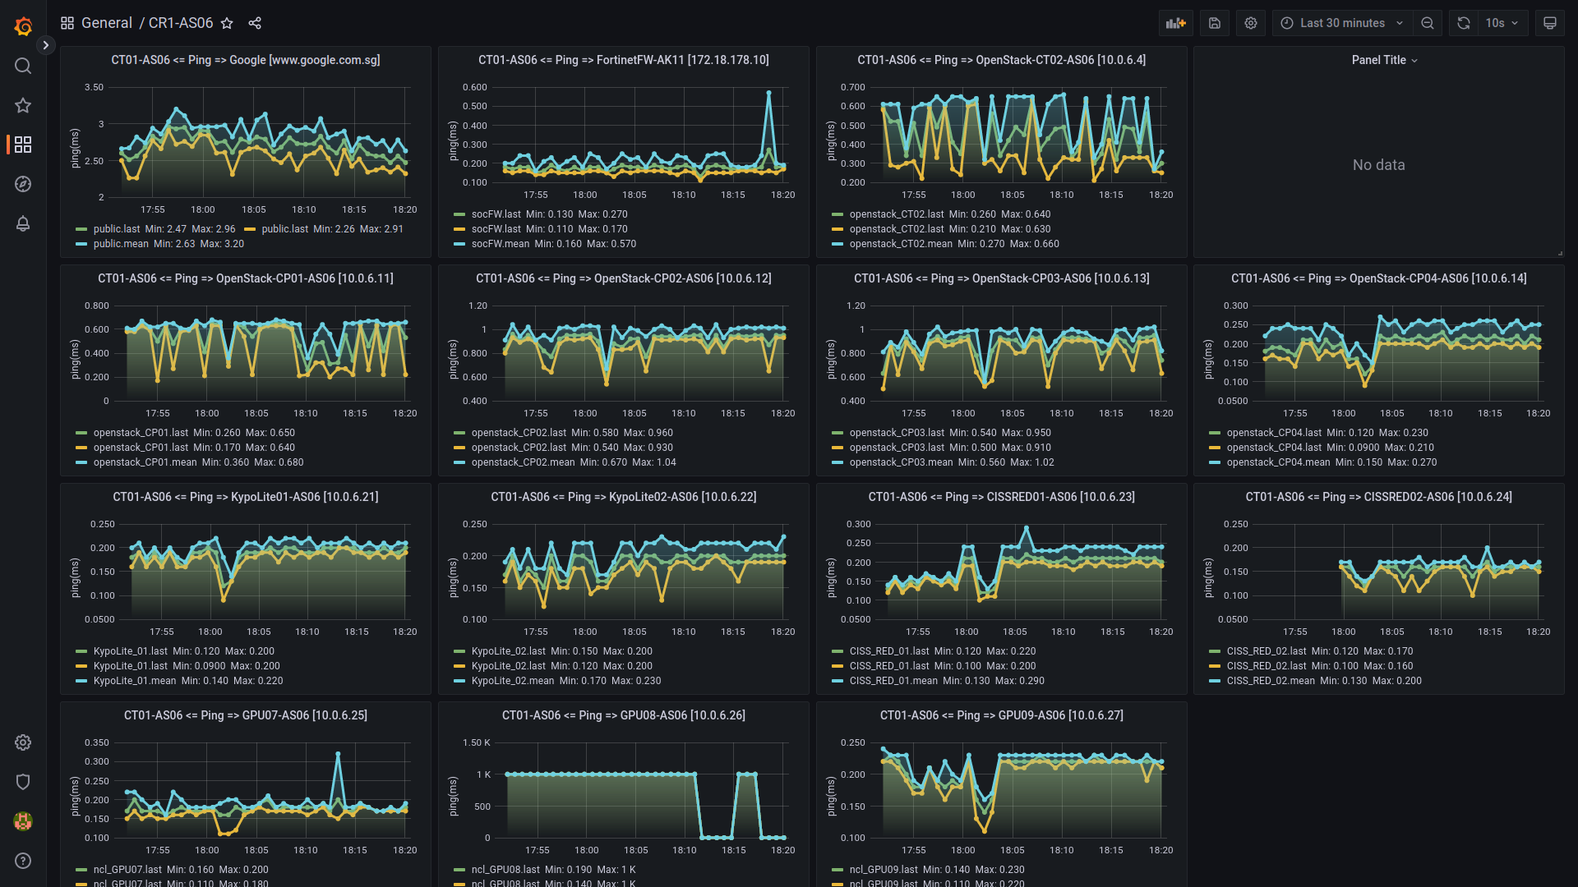
NCL Cyber Exercise Resource Monitor System
3. Resource Availability Dashboard
The Resource Availability Dashboard will show the detailed real time availability state of exercise resource ( hardware, vms, containers, program or service) to fill full the requirement of different cyber exercise team:
Black/Judgement-Team can use it to evaluate the specific teams’ score or action.
Red-Team can use it to check the influence of the launched attack of the exercise cluster.
Green-Team can use it to monitor the critical nodes/hosts connection, then analyse the exercise process and debug the exception situation happens during the event.
Purple-Team can use it to archive the exercise cluster’s whole resource situation.
Resource availability dashboard example:
Critical nodes connection dashboard example:

Slide 6
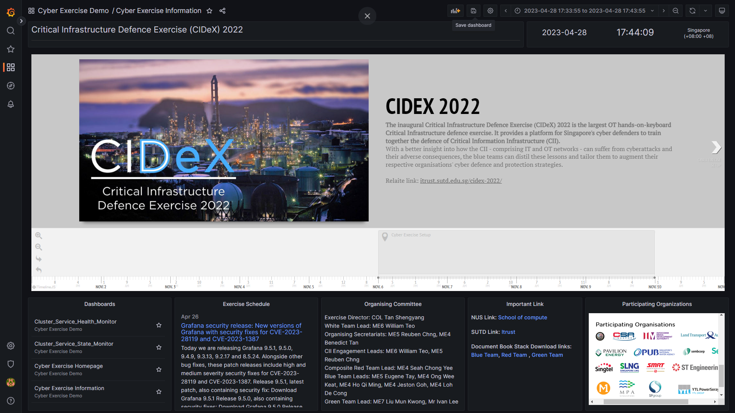
Information Dashboard
Information and announcement post page:
Used by purple-team to post the announcement to blue team, archiving the exercise document, post information to public (as a home page).
Panels included:
Time panel.
Exercise timeline panel (New exercise timeline system).
Dashboard list panel.
Exercise Schedule panel
Organising Committee panel
Exercise related document download panel.
Participating Organizations display panel.

Slide 7
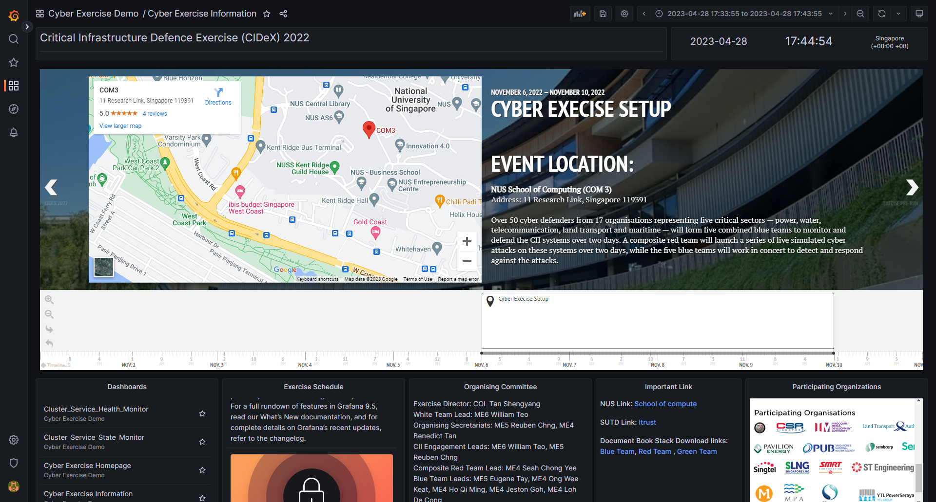
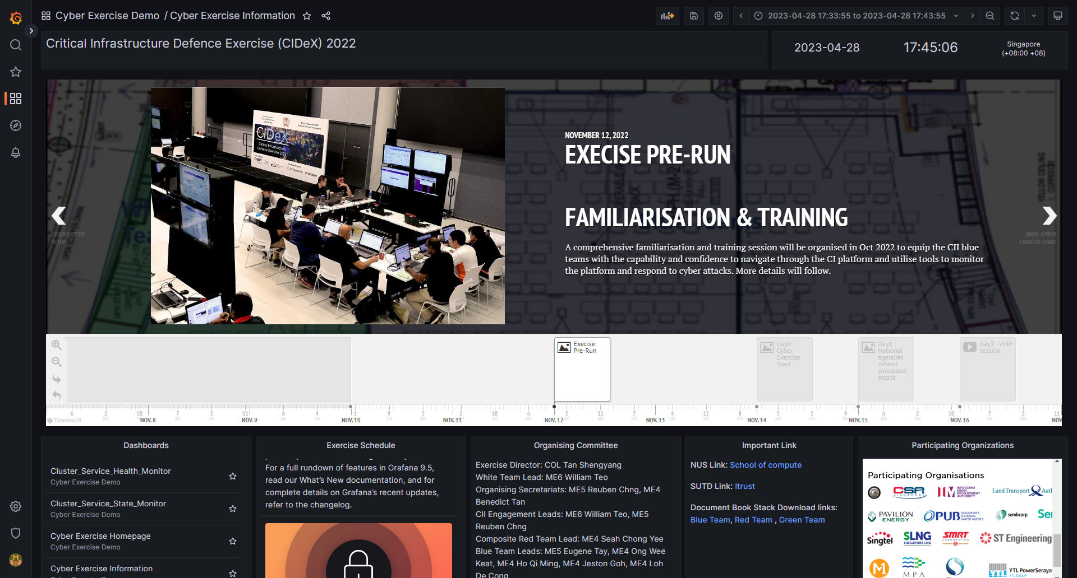
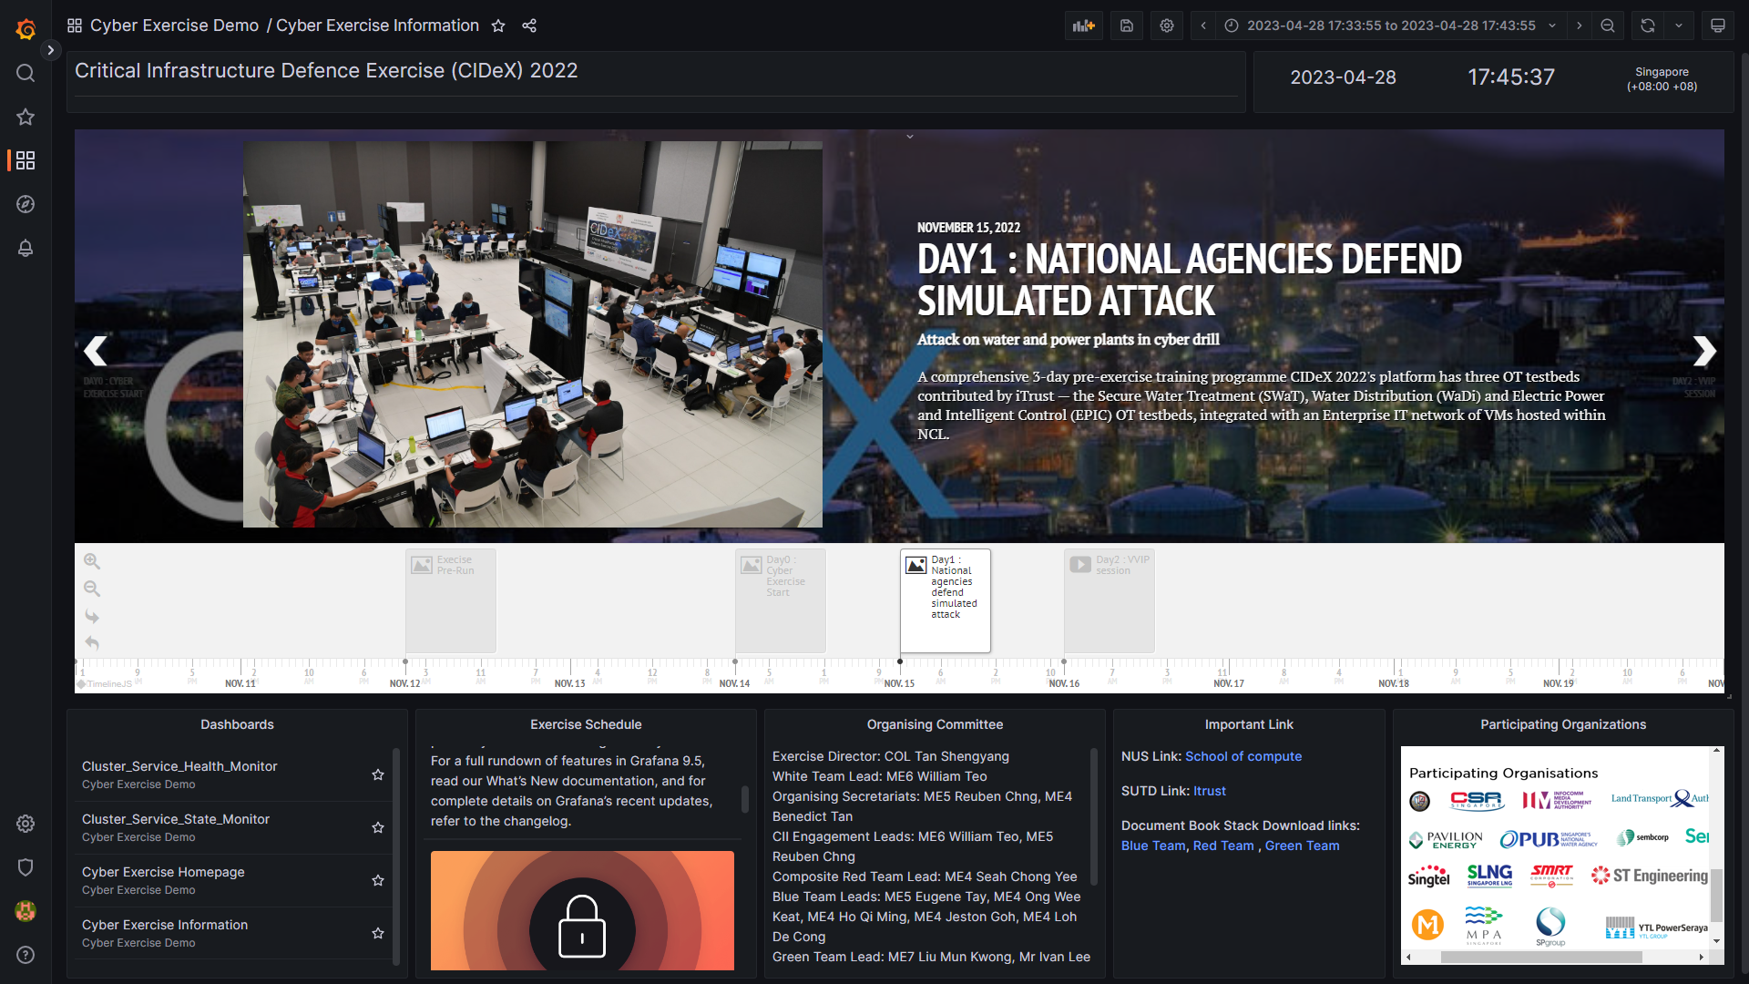
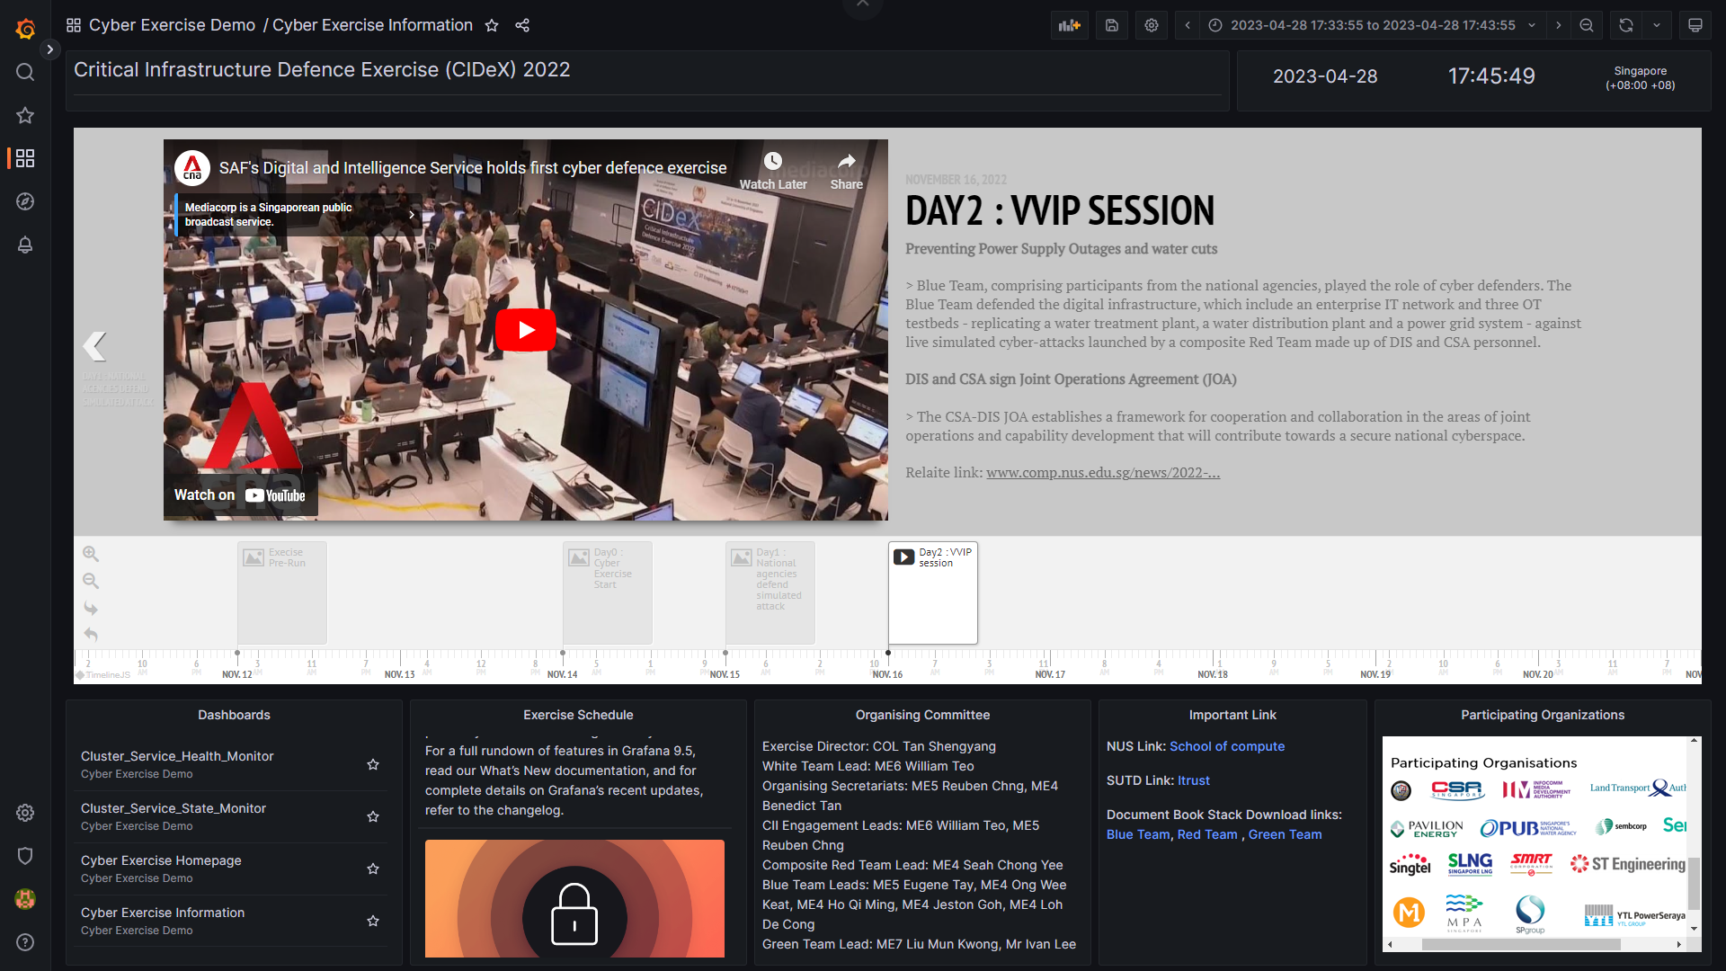
Information Dashboard
Support exercise venue Google map direction plugin :
Support MINDEF Exercise introduction (auto grab and synchronize ) plugin:
Support SUTD Exercise state (auto grab and synchronize ) plugin:
Support video (YouTube) plugin:

Slide 8
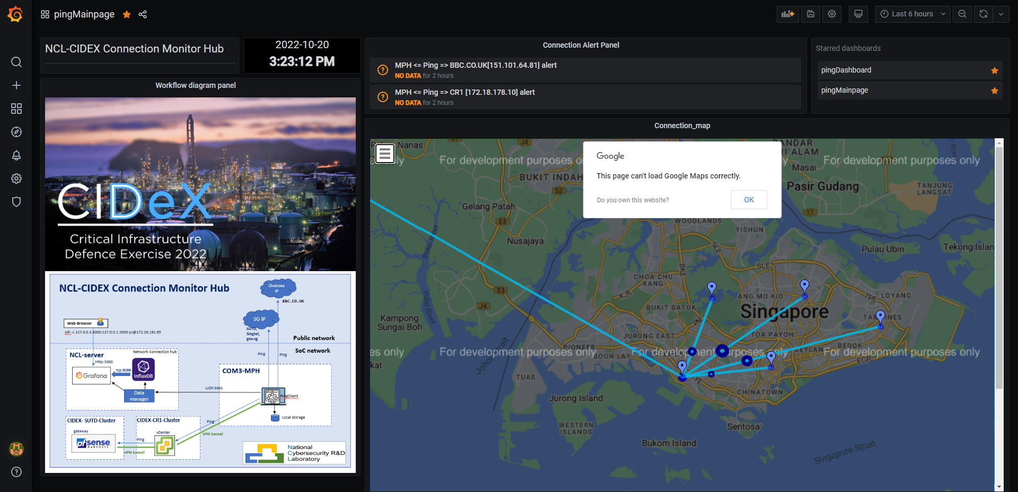
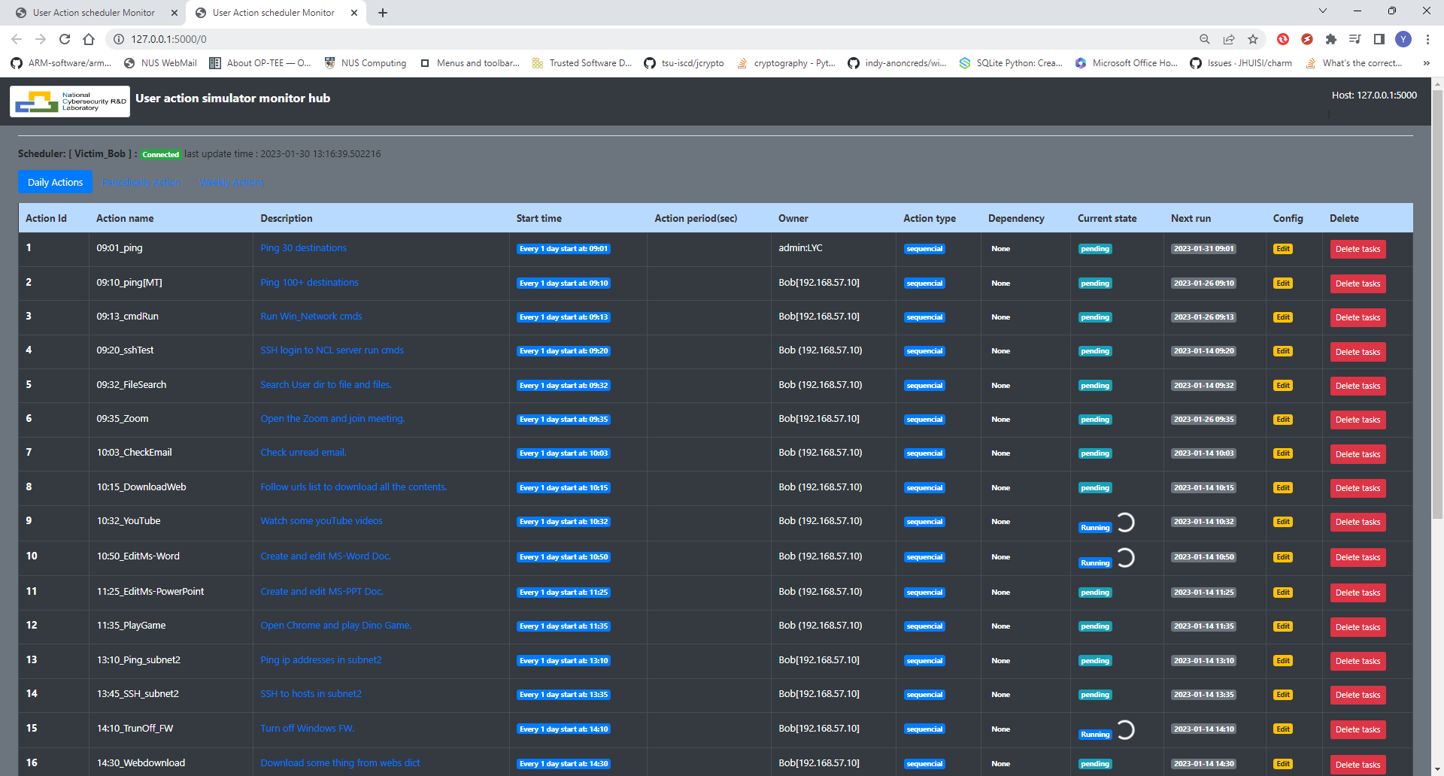
NCL Cyber Exercise Resource Monitor System
4. Assistance Function Dashboard
The Assistance Function Dashboard includes several customized dashboards which visualize the execution state of the specific function used to full filled the customers’ additional requirement. The dashboards includes:
Dashboard show normal users’ behavior simulation state and traffic generation state for Yellow-Team.
Dashboard show the attack launched and unexpected(harmful) action auto triggered state for Red-Team
Dashboard show the internet connection, VPN bandwidth usage for Green-Team to support the event.
Internet and VPN Peer Connection monitor dashboard (used by Green team) example:
Auto attack, normal user simulation and traffic generation monitor dashboard:

Slide 9
NCL Cyber Exercise Resource Monitor System
Technical detail
The Cyber Exercise Resource Monitor System is built based on two NCL exist product: Cluster User Emulator and Cluster Service Health Monitor :
Cluster Users Emulator
The Cluster Users Emulator is a multiple users’ action emulation system running in a network/compute cluster system which can satisfy the customers’ requirement. During the cyber exercise, it is used to simulate normal users' behavior, generate network traffic, auto launch attack, or generate unexpected action.
Detailed program technical document: <User_Action_Emulator_Design_Doc_v0.2.pdf>
Cluster Service Health Monitor
The Cluster Service Heath Monitor is a systemed function/service monitoring program to check and evaluate the cyber security computing cluster's critical points (node, service, function, file system) availability in real time during the cyber exercise. A service prober lib repository , a prober agent and one data processing hub are provided by the monitor system.
Detailed program technical document: < Cluster Service Health Monitor_DesignDoc .pdf>

